Slide 1
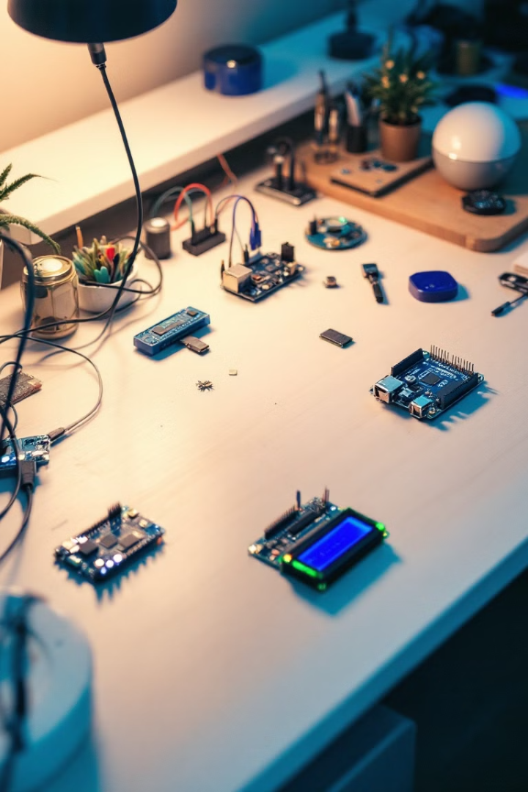

NodeMCU, ESP32, and ESP8266: A Comprehensive Overview
Demystifying IoT Development Platforms. Exploring Features, Differences, and Pinouts.
Target Audience: Hobbyists, Engineers, and IoT Enthusiasts.
by swaraj upgrad

Slide 2
What is NodeMCU?
Definition
Key Features
Open-source IoT platform. It is based on the ESP8266.
Lua-based firmware
Wi-Fi connectivity
Breadboard-friendly
Pre-flashed firmware
Emerged as a popular prototyping tool. Released in 2014, gained traction due to its ease of use.

Slide 3
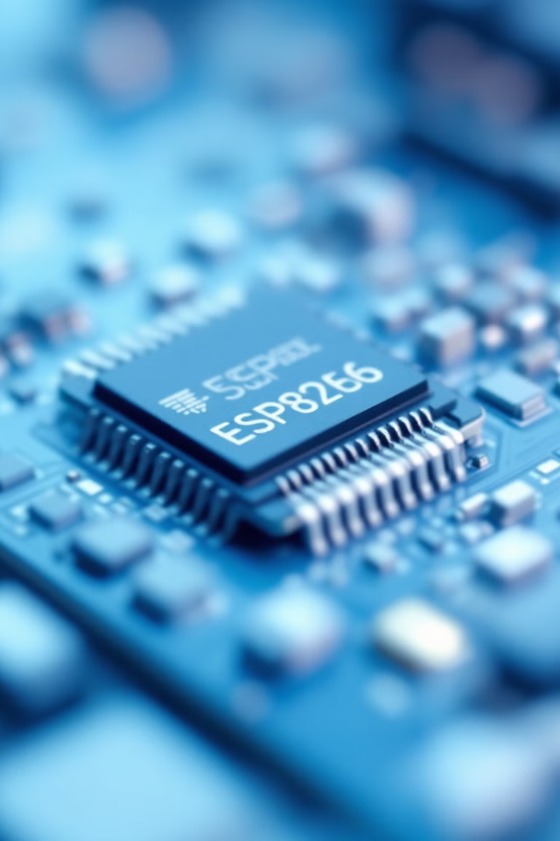
ESP8266: The Heart of NodeMCU
1
Overview
2
Key Specifications
ESP8266 SoC (System on a Chip) details.
32-bit RISC CPU. Clock Speed: 80 MHz. Wi-Fi: 802.11 b/g/n.
3
Strengths
Low cost, low power. Adequate for simple IoT tasks.
Limitations: Limited processing power. Example Use Cases: Sensor monitoring, smart plugs.

Slide 4
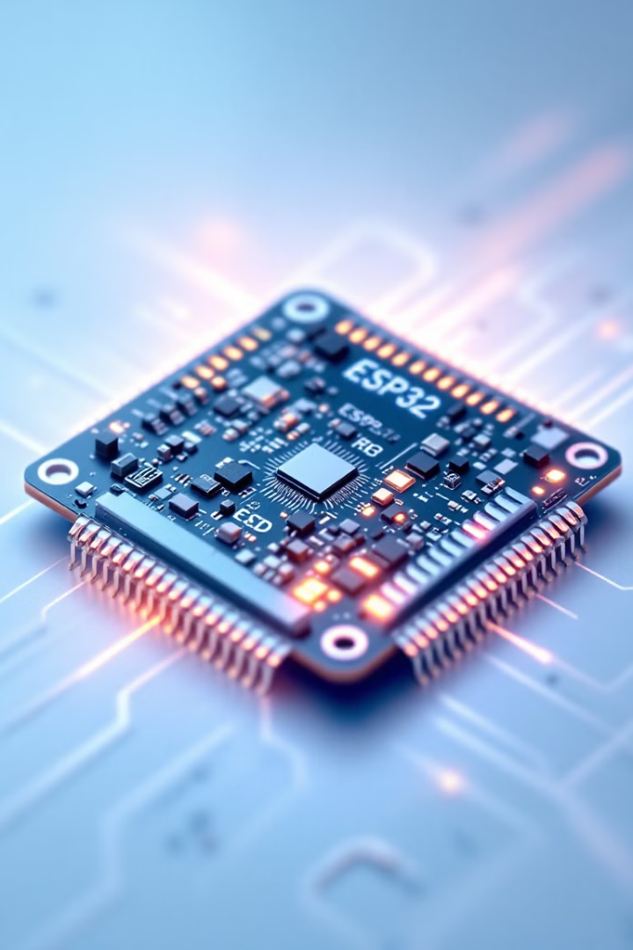
ESP32: The Enhanced Successor
Overview
Key Specifications
ESP32 SoC (System on a Chip) features.
Dual-core 32-bit RISC-V. Clock Speed: Up to 240 MHz. Bluetooth: v4.2.
Strengths
Higher processing power and more peripherals.
Example Use Cases: Advanced IoT devices and wearable technology.

Slide 5
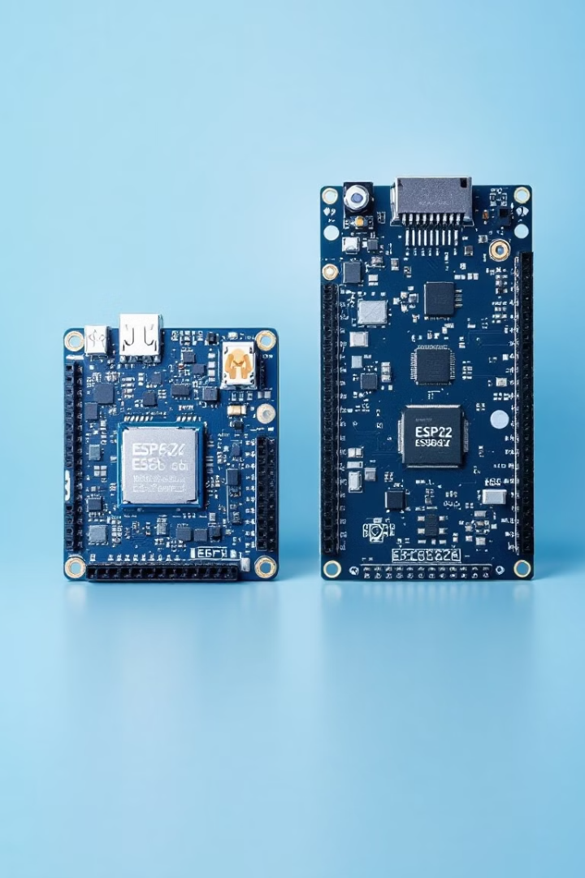
Feature Comparison: ESP8266 vs. ESP32
Feature
ESP8266
ESP32
CPU
32-bit RISC
Dual-core 32-bit
Clock Speed
80 MHz
Up to 240 MHz
Bluetooth
No
Yes
Memory
64KB RAM
520KB RAM
GPIOs
Limited
More

Slide 6
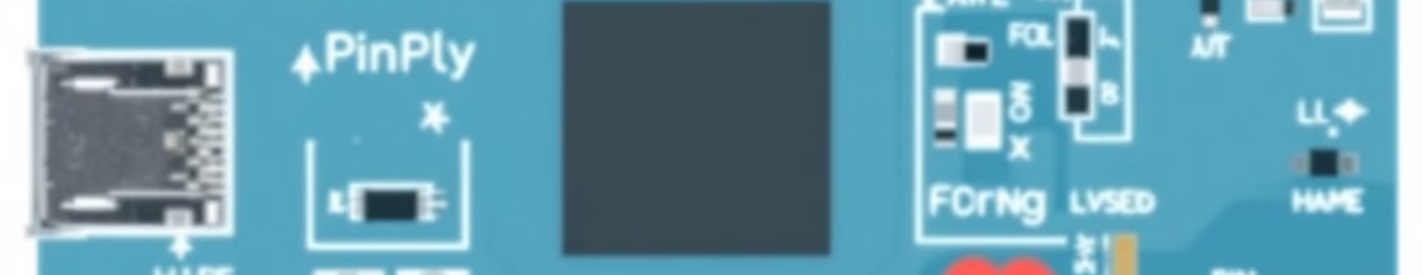



NodeMCU Pinout Deep Dive
Digital I/O
Analog Input
Communication
D0-D8 for digital input and output.
A0 pin for analog signal reading.
UART, SPI, and I2C interfaces.
Understanding alternative pin functions. D3 and D4 commonly used for I2C.

Slide 7



ESP32 Pinout Exploration
Analog I/O
2
ADC1/2 and DAC1/2 provide analog capabilities.
Digital I/O
1
GPIO0-GPIO39 offer digital functionality.
Communication
3
UART, SPI, and I2C options available.
Flexible peripheral pin mapping is supported. Use caution with internal function pins.

Slide 8
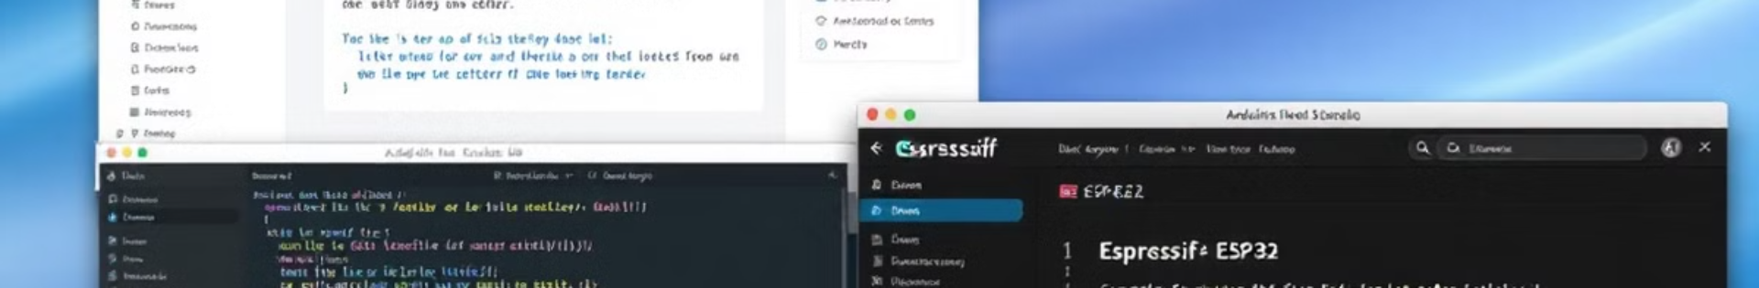
Programming Environments and Languages
NodeMCU
1
Lua scripting and Arduino IDE support.
2
ESP32
Arduino IDE and MicroPython are supported.
Libraries
3
WiFiManager, PubSubClient, and ArduinoJson.
Espressif IDF (C/C++) available for ESP32. Popular libraries simplify IoT development.

Slide 9
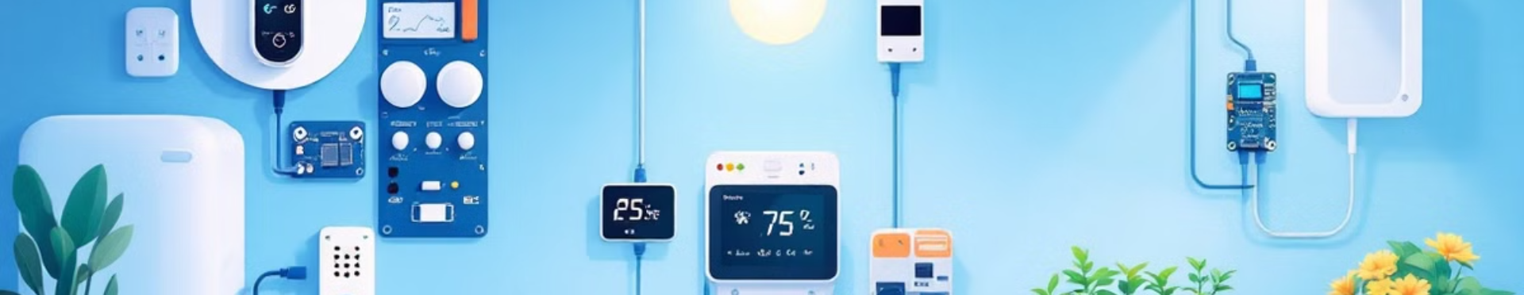



Practical Applications and Project Ideas
ESP8266
ESP32
Project
Smart Home Automation and Weather Station.
Camera surveillance and wearables.
Smart Agriculture Monitoring System.
Voice-controlled devices with ESP32. Example project cost: under $50 USD.

Slide 10



Conclusion: Choosing the Right Platform
1
Complex
2
Advanced
3
Simple
ESP8266 is suitable for low-cost, simple applications. ESP32 is ideal for complex projects.
Future Trends: AI/ML integration on these platforms. Explore the vibrant IoT community!

